Slide 1
A novel circular economy for sustainable RE-based magnets
associated partners

Slide 2
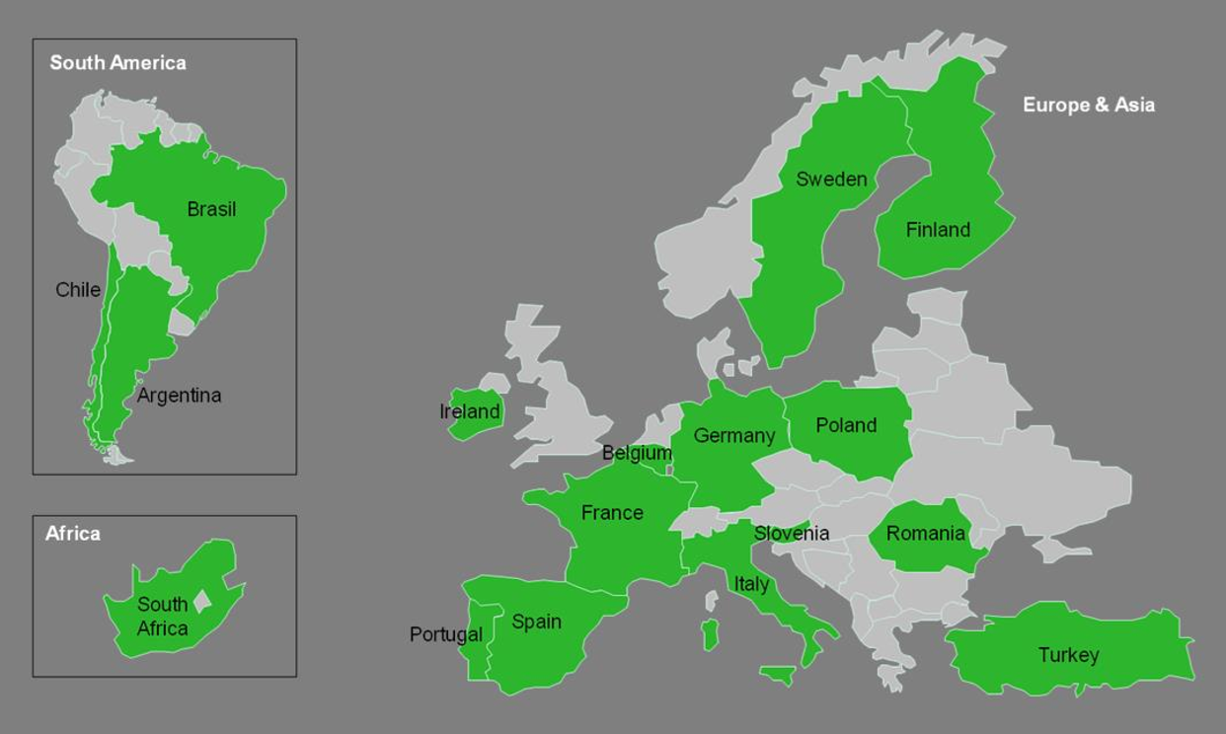
ERA-MIN 2 2018
ERA-NET Cofund on Raw Materials (ERA-MIN 2) is public-public partnerships funded under Horizon 2020. ERA-MIN 2 aims to implement a European-wide coordination of research and innovation programmes on raw materials to strengthen the industry, competitiveness and the shift to a circular economy.
The ERA-MIN 2 consortium consists of 21 funding organizations from 18 countries/regions
Each beneficiary in a proposal is funded by the Funding Organisation of their own country/region
Each country has its own funding regulations and budget

Slide 3
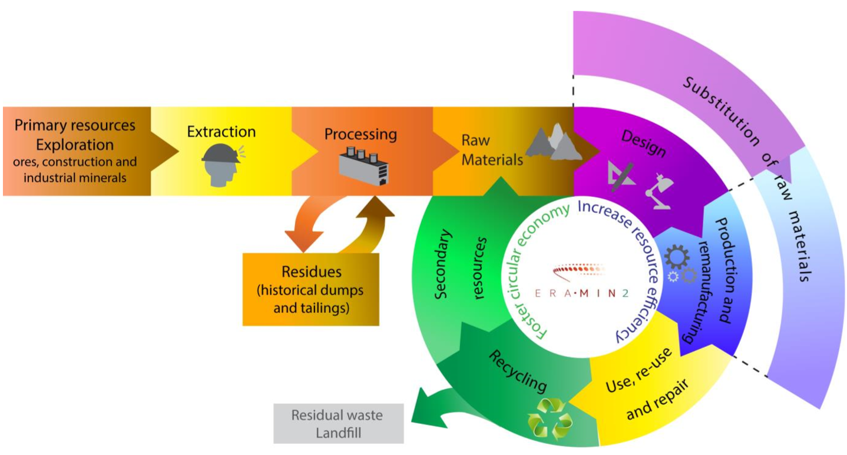
ERA-MIN 2 2018
The scope of the Joint Call is demand-driven research and innovation on primary and secondary resources of metallic, construction and industrial minerals and substitution of Critical Raw Materials
Topics:
Supply of raw materials from exploration and mining
Design
Processing, Production and Remanufacturing
Recycling of End-of-Life Products
Cross-cutting topics

Slide 4
PROJECT TITLE: A novel circular economy for sustainable RE-based magnets
TOPIC: Processing, Production and Remanufacturing
PROJECT DURATION: 36 Months ( 05 / 2018 to 04 / 2021 )
THE OBJECTIVE: The objective of the MaXycle project is to use a more systematic approach when recycling EOL NdFeB magnets, which would help to recycle 15% of all the magnets produced by 2025. It will develop and validate a systematic approach to overcome the barriers currently hindering a successful circular economy for NdFeB-type magnets on an industrial scale.

Slide 5
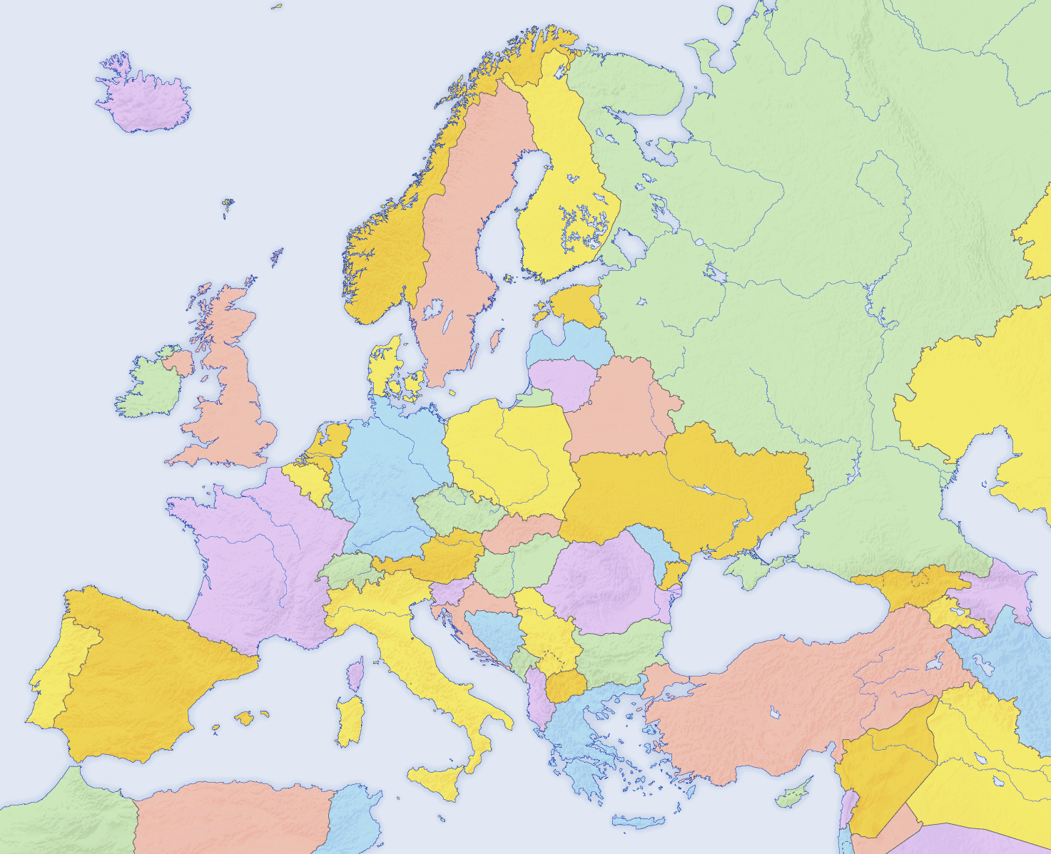
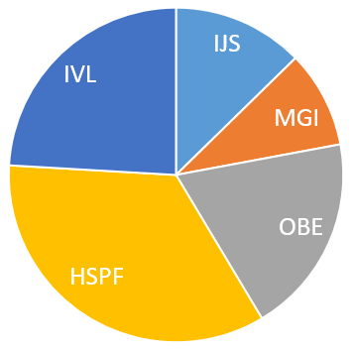
Consortium (5 partners from 3 countries)
IVL Swedish Environmental Research Institute (Sweden)
Total Costs
Pforzheim University of Applied Sciences (Germany)
OBE Ohnmacht & Baumgärtner GmbH & Co.
KG (Germany)
Jozef Stefan Institute (Slovenia)
Magneti Ljubljana, d.d. (Slovenia)
 | PARTNER | Acronim | EU funding
1. | Jozef Stefan Institute (Slovenia) | IJS | 134.420 € (100%)
2. | Magneti Ljubljana, d.d. (Slovenia) | MGI | 74.700 € (75%)
3. | OBE Ohnmacht & Baumgärtner GmbH & Co. KG (Germany) | OBE | 135.528 € (66%)
4. | Pforzheim University of Applied Sciences (Germany) | HSPF | 365.922 € (100%)
5. | IVL Swedish Environmental Research Institute (Sweden) | IVL | 255.400 € (100%)

Slide 6
RE magnet demand
RE magnets underpin an industry worth in excess of $1 trillion worldwide.
Driven by increased adoption of electric vehicles and green technologies, the global demand for NdFeB magnets (~80,000 t/a 2017) could grow at 15-20%/annum for the next decade.
Currently less than 1% of the world’s REs are being recycled.
The EU import far more Nd-Fe-B magnets than they manufacture (approximately 1,000 tonnes per year).
It is estimated that the total recycling potential for RE magnets worldwide as being in the range 14,000–20,000 tonnes per year by 2020.
In the EU this figure can be put at around 2,000–3,000 tonnes/annum

Slide 7
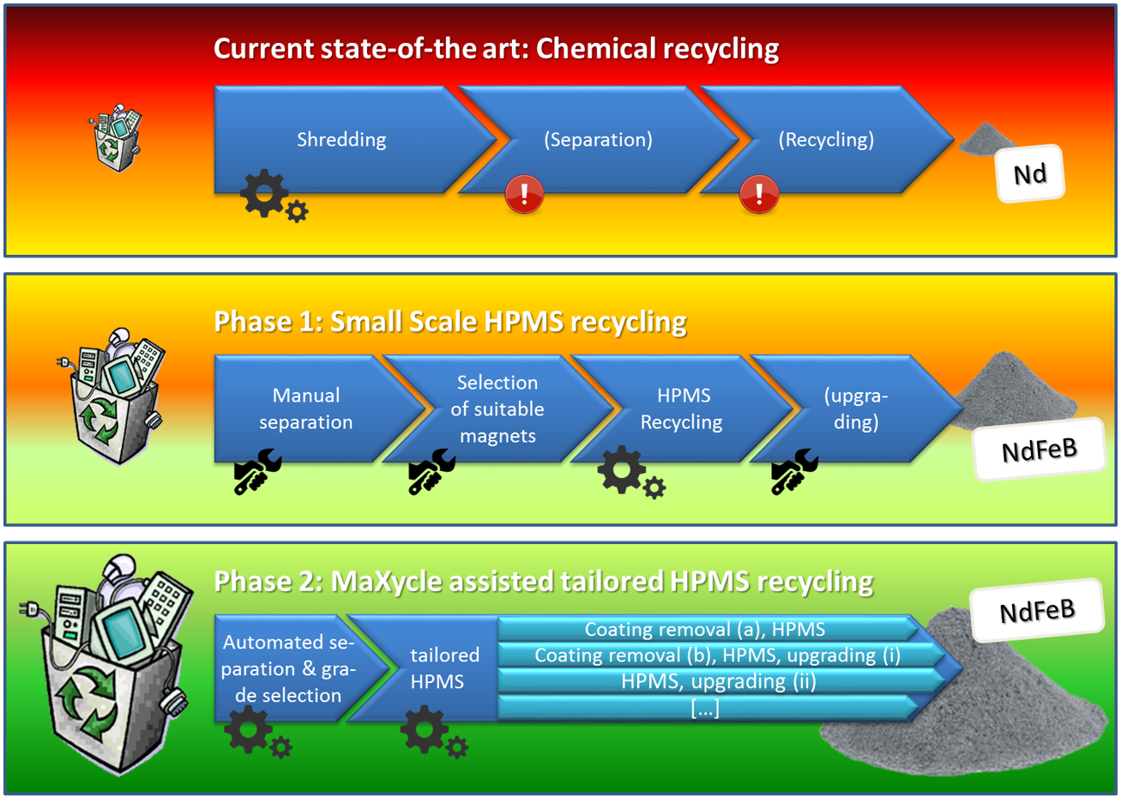
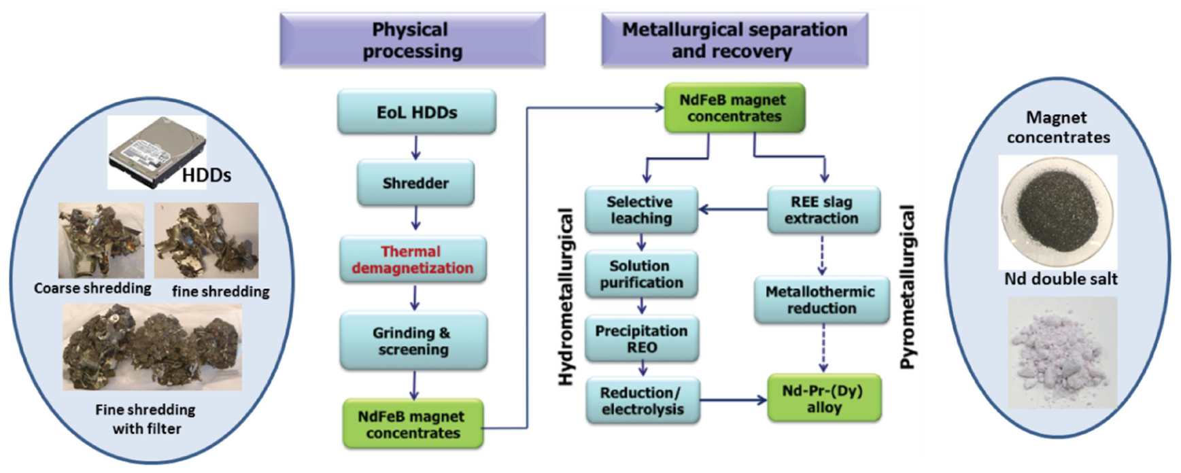
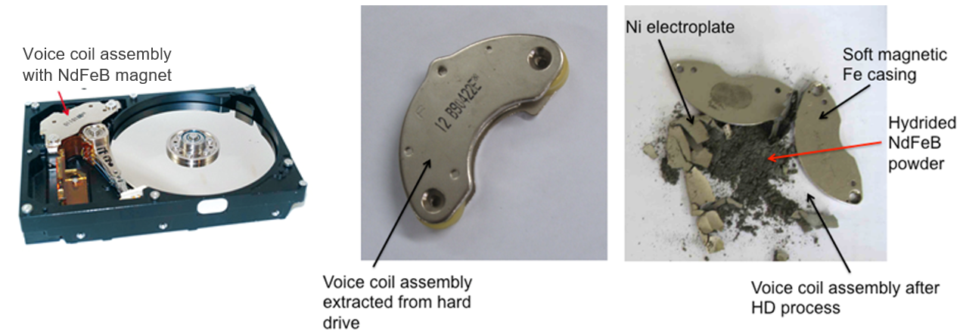
State of the art
Recycling of NdFeB material from hard disk drives (HDD) by chemical or pyrometallurgical processes
Illustration of the Hydrogen Processing of Magnet Scrap (HPMS) process applied to a voice coil magnet of a hard disk drive

Slide 8
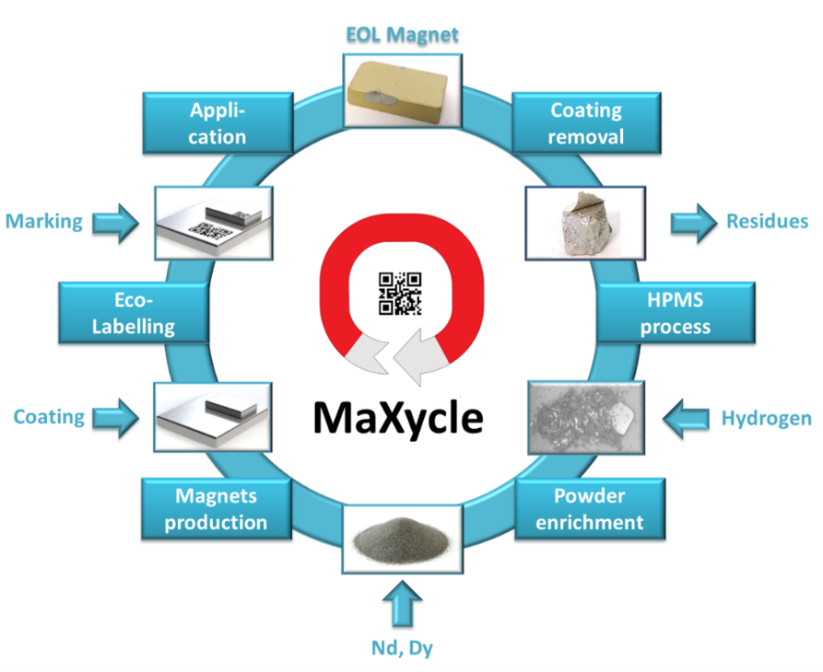
The MaXycle process

Slide 9
The MaXycle process
1
Definition of standardised quality criteria for EOLM and a classification system for contamination levels to categorise products by pre-processing requirements.
2
Development of a labelling system for newly produced RE magnets to identify different magnet types and qualities, including provision of reliable and durable marking methods.
3
Investigation of treatments to eliminate pre-processing residues/coatings to avoid contamination in the HPMS process.
4
Investigation to upgrade properties of recycled EOLM based on powders of different contamination levels.
5
A circular economy evaluation of impacts for industrial upscaling of new methods by means of LCA and TEA investigations.

Slide 10
Methodology
WP1: Project Management (JSI, all partners)
WP2: Classification system for EOL magnets (HSPF, JSI, MGI, UOB, RKL)
WP3: Eco-labelling system for hard magnets (HSPF, OBE, RKL, UOB)
WP4: Coating removal from EOL NdFeB magnets (JSI, HSPF, MGI)
WP5: Upgrading EOL NdFeB magnets (MGI, OBE, JSI, HSPF)
WP6: Circular economy impacts evaluation (IVL, all partners)
WP7: Dissemination & Exploitation (JSI, all partners)

Slide 11
WP1 JSI
WP1: Project Management (JSI, all partners).
To ensure an efficient and pro-active coordination of the project through an effective administration, organisation and monitoring of the technical, administrative and financial components of the project.
T1.1 Scientific coordination of the project
M1-36
Monitoring of project's progress and activities performed by the consortium with respect to the work plan
Ensuring the appropriate and timely completion of projects' tasks
Monitoring of project's progress and activities performed by the consortium with respect to the work plan
Preparation and submission of reports and deliverables

Slide 12
WP1 JSI
WP1: Project Management (JSI, all partners).
T1.2 Administrative management of the project
M1-36
General project administration
Preparing and post-processing of EC reviews
Preparing, executing and post-processing of major project meetings
Drafting and maintaining the dissemination and exploitation plan
Preparation and submission of the mandatory management reports

Slide 13
WP1 JSI
WP1: Project Management (JSI, all partners).
T1.3 Financial & accounting management
M1-36
Preparation of the financial and budgetary reports
Controlling of the overall budget
To administer the Community financial contribution regarding its allocation between beneficiaries and activities
To keep the records and financial accounts (web-based professional project management tool)
To inform the Commission of the distribution of the Community financial contribution

Slide 14
WP1 JSI
WP1: Project Management (JSI, all partners).
T1.4 Communication & Knowledge management
M1-36
Set-up of common rules and procedures for the communication of information and results within the project
Handling of the project correspondence and the day-to-day requests from partners and external bodies
Set-up and maintenance of a project intranet and a data repository for the consortium

Slide 15
WP1 JSI
WP1: Project Management (JSI, all partners).
Deliverables
1.1 Set up of intranet and data repository
M 2
1.2 Set up of project management tool
M 2
1.3 6-months interim progress report
M 7
1.4 12-months progress report for the JCS
M 13
1.5 Mid-term report
M 19
1.6 24-months progress report for the JCS
M 25
1.7 30-months interim progress report
M 31
1.8 Final report
M 36

Slide 16
WP1 JSI
WP1: Project Management (JSI, all partners).
Milestones
Kick-Off Meeting
M 1
Mid-Term Project Review Meeting
M 19
Project closure/final meeting
M 36

Slide 17
WP2 HSPF
WP2: Classification system for EOL magnets (HSPF, JSI, MGI, UOB, RKL)
Standardised quality criteria for EOL NdFeB magnets will be determined and translated into a classification system. Taking into account the results created in WP4 and WP5,
T2.1 Definition and collection of data
M1-12
Definition of the required data to establish a robust, reliable and accurate classification system.
Information includes chemical composition, heavy rare earth content, manufacturing method, and coating.
The grading system will be open for additional recycling relevant information like field of application, operating conditions,...

Slide 18
WP2 HSPF
WP2: Classification system for EOL magnets (HSPF, JSI, MGI, UOB, RKL)
T2.2 Definition of test methods for EOLM
M8-19
Acquire the data needed for the selection of appropriate remanufacturing methods.
Appropriate tests will be defined based on the results from WP4 and WP5, that are cost efficient and fast.
T2.3 Development of recyclate grading system
M13-24
An alphanumerical grading system will be developed that
encodes the info in a machine readable manner
Find the balance between detailed information and a simple,
easy-to-use system.

Slide 19
WP2 HSPF
WP2: Classification system for EOL magnets (HSPF, JSI, MGI, UOB, RKL)
T2.4 Setup of a database system
M16-32
Setup of a database system for the recyclate grading system
An open-access database with easy interfaces and search features will be created and filled with project results.
Publicly available via the MaXycle website
The basis for the project’s standardization efforts for the
characterization of EOL magnets.

Slide 20
WP2: Classification system for EOL magnets (HSPF, JSI, MGI, UOB, RKL)
Deliverables
WP2 HSPF
2.1 Definition of classification data
M 13
2.2 Recyclate grading chart
M 25
2.3 Classification system
M 33
2.4 Open access recyclate grading data base
M 34
Milestones
Development of a classification system
M 33

Slide 21
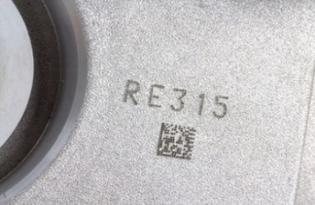
WP3 HSPF
WP3: Eco-labelling system for hard magnets (HSPF, OBE, RKL, UOB)
Development of a universal, durable, corrosion-resistant labelling system for newly produced magnets, ensuring that the stored information will still be readable by a potential recycler on EOL magnets in an automated manner, while not influencing the properties of the magnet.
T3.1 Development of labelling model
M1-12
Collect the required data for successful and efficient recycling an EOL magnet and in cooperation with the associated partners.
Translated into a labelling system allowing easy identification
and sorting at the recycler

Slide 22
WP3 HSPF
WP3: Eco-labelling system for hard magnets (HSPF, OBE, RKL, UOB)
T3.2 Labelling trials (subsurface labelling)
M8-19
Powder markers with a particle size in the micro/nanometer range will be tested, mixed in the magnet powder itself or in the coating
The readability of the system (speed and reliability) and a possible effect of the markers on the magnetic properties will be tested
T3.3 Labelling trials (surface labeling)
M9-20
Testing of surface labelling based on data matrix code systems (DMC, bar or QR code) , e.g printing, dotting, laser engraving
Fluorescence marking system (Smartwater) will be investigated

Slide 23
WP3 HSPF
WP3: Eco-labelling system for hard magnets (HSPF, OBE, RKL, UOB)
T3.4 Endurance trials for labelling systems
M13-24
To ensure that the eco-labelling will survive the harsh conditions, artificial ageing tests will be used:
Scratch tests
Environment chamber tests,
Chemical resistant tests

Slide 24
WP3: Eco-labelling system for hard magnets (HSPF, OBE, RKL, UOB)
Deliverables
WP3 HSPF
3.1 Definition of data required
M 13
3.2 Report on labelling trials-subsurface
M 20
3.3 Report on labelling trials-surface
M 21
3.4 Report on life endurance trials
M 25
3.5 Eco-labelling system
M 25
Milestones
Selection of a suitable labelling system
M 25

Slide 25
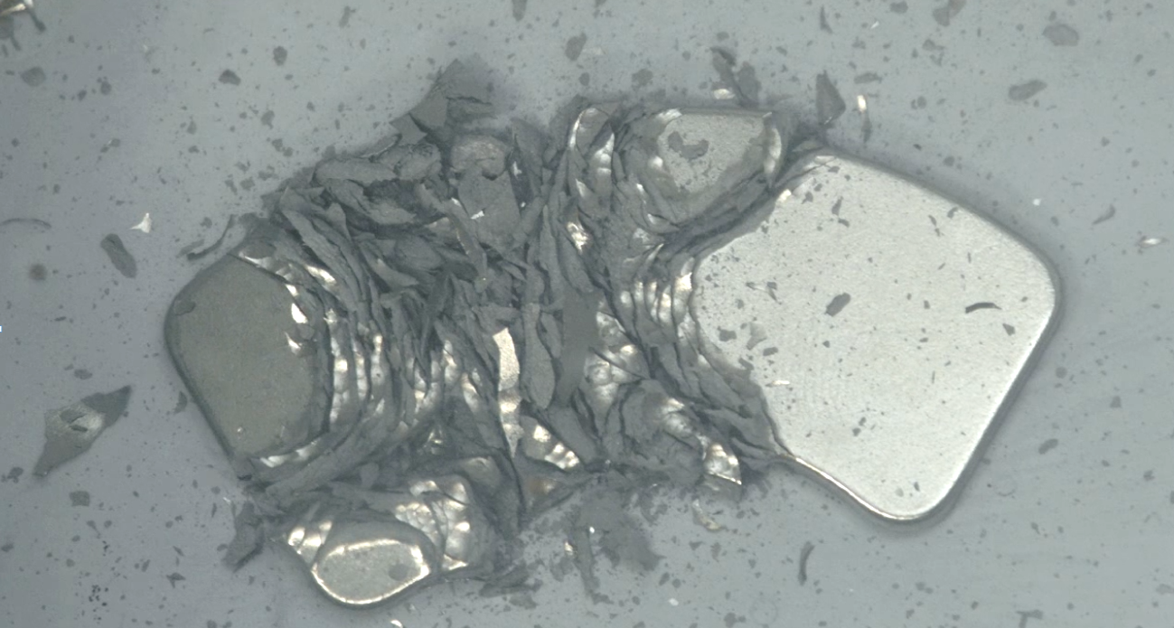
WP4 JSI
WP4: Coating removal from EOL NdFeB magnets (JSI, HSPF, MGI)
WP4 investigates methods to remove corrosion protection coatings from magnets before and during HPMS treatment, and separation from HPMS-recycled powders on an industrial scale.
T4.1 Analysis of coating layers
M1-12
Coatings of different magnets provided by recycling companies, Magneti, OBE and other magnets manufacturers will be analysed
Chemistry, layer structure, thickness etc. of the coating will be determined.
Parameters for appropriate coating removal techniques will be determined.

Slide 26
WP4 JSI
WP4: Coating removal from EOL NdFeB magnets (JSI, HSPF, MGI)
T4.2 Removal of coating layers and residues
M6-16
Existing lab methods will be evaluated for feasible upscaling, like dissolving in acids, reverse galvanization and use of ionic liquids.
HPMS treated magnets will be investigated for residues
T4.3 Analysis of coating residue
M7-19
Compositions of de-coated magnets and HPMS magnets will be screened for coating residues
Define the maximum allowance of coating residue in recycled materials

Slide 27
WP4 JSI
WP4: Coating removal from EOL NdFeB magnets (JSI, HSPF, MGI)
T4.4 New coatings
M19-33
The possibilities of applying new coating techniques to magnets and their possible benefits on magnet recycling
A self-healing coating, which would extend the life of magnets
A polymer based coating, which is mechanically resistant, but easily removal

Slide 28
WP4: Coating removal from EOL NdFeB magnets (JSI, HSPF, MGI)
Deliverables
WP4 JSI
4.1 Report on coating analysis
M 13
4.2 Report on coating/residue removal
M 17
4.3 Report on analyses of coating residues
M 20
4.4 Report on new coatings
M 34
Milestones
Suitable coating removal technique
M 34

Slide 29
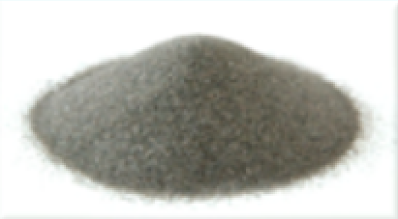
WP5 MGI
WP5: Upgrading EOL NdFeB magnets (MGI, OBE, JSI, HSPF)
WP5 researches the upgrading of HPMS-recycled powders. This includes reduction of particle size by sieving/milling, addition of Nd via casted master alloys/powder blending, etc. For different contamination levels, the most suitable methods will be identified.
T5.1 Feedstock preparation
M7-19
Different HPMS recycled feedstocks for magnet production will be prepared
Special focus is given to the state of oxidation, which results in poor magnetic properties
Enhancements to the HPMS powder have to be made by increasing the Nd-content, or increasing the HRE content

Slide 30
WP5 MGI
WP5: Upgrading EOL NdFeB magnets (MGI, OBE, JSI, HSPF)
T5.2 Conventional and SDS processing
M9-33
Produce NdFeB magnets of the 5.1 feedstocks via conventional press sintering, polymer bonding and SDS processing
Optimizing processing parameters: injection rates, heating ramps temperatures, pressures, sintering times, etc.
T5.3 Spark plasma sintering
M20-33
Compositions of de-coated magnets and HPMS magnets will be screened for coating residues
Define the maximum allowance of coating residue in recycled materials

Slide 31
WP5: Upgrading EOL NdFeB magnets (MGI, OBE, JSI, HSPF)
Deliverables
WP5 MGI
5.1 Report on feedstock preparation
M 20
5.2 Report on conventional/SDS production
M 34
5.3 Report on spark plasma sintering
M 34
Milestones
Optimised processing parameters
M 34

Slide 32
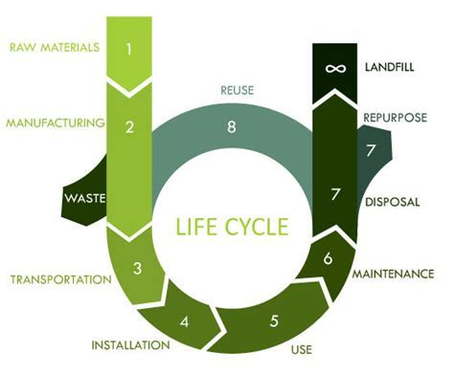
WP6 IVL
WP6: Circular economy impacts evaluation (IVL, all partners)
Scenarios for industrial upscaling will be elaborated, including a thorough LCA compared to the LCA for primary production of NdFeB from mined sources of materials. TEA will be performed and used to guide the most promising reprocessing routes in the project.
T6.1 Literature review
M1-9
Literature review of the environmental impact of RE magnets and recycling options
Including the environmental impact of conventional coating removal methods for polymer bonded and sintered magnets
Using data already available from the FP7/HORIZON2020 projects
“REMANENCE”, “REProMag” and “ROMEO”

Slide 33
WP6 IVL
WP6: Circular economy impacts evaluation (IVL, all partners)
T6.2 Environmental impact assessment
M6-33
The environmental impact of the suggested routes defined within the project compared to conventional methods
Focus on the labelling system and coating removal and upgrading routes for recycled magnets
T6.3 Economic impact
M16-33
the economic impact of the new approachs will be considered with the help of a Life Cycle Cost approach
Total cost of acquiring, owning, using, and disposing of the production line

Slide 34
WP6 IVL
WP6: Circular economy impacts evaluation (IVL, all partners)
T6.4 Health & Security assessment
M26-36
Investigating any potential safety considerations needed for working with RE magnets/powders
Respective data sheets will be collected from partners
The resulting report will establish guidelines for a controlled, safe working environment for the recycling and production of RE magnets

Slide 35
WP6: Circular economy impacts evaluation (IVL, all partners)
Deliverables
WP6 IVL
6.1 LCA for conventional recycling
M 10
6.2 LCA for suggested recycling
M 34
6.3 Life Cycle Cost report
M 34
6.4 Health and safety report
M 36
Milestones
LCA/LCC completed
M 34
Health & Safety Report completed
M 36

Slide 36
WP7 JSI
WP7: Dissemination & Exploitation (JSI, all partners).
This work package is dedicated to communication and exploitation of project results and achievements to identified target audiences to maximise active involvement and impact.
T7.1 Dissemination and Communication
M1-36
Provision of information for target groups about project achievements through printed and digital materials.
Dedicated website, 4 press releases, 3 electronic newsletters, publishing of papers in top journals, public outreach activities

Slide 37
WP7 JSI
WP7: Dissemination & Exploitation (JSI, all partners).
T7.2 Technology and knowledge transfer
M4-33
The task will raise awareness of the real costs of magnets and the rarity of the materials involved
The consortium will organise two training workshops to promote the grading and labelling system and other project results
Publish four open access scientific/industrial publications. give five or more presentations at fairs and conferences
T7.3 Technology and market watch
M4-36
Technology and market watch activities will be performed by the means of IPR surveys and trademark research in specialised databases. to identify relevant patents or technologies and trademark infringements

Slide 38
WP7 JSI
WP7: Dissemination & Exploitation (JSI, all partners).
T7.4 Management of IP
M13-36
Two IPR exploitation workshops will be held during the partner meetings to identify exploitation strategies of project results
Delivering important input for the exploitation plan in task 7.5
T7.5 Exploitation plan (EP)
M3-36
It will describe targeted exploitation activities as well as a general exploitation strategy
An initial draft exploitation plan will be prepared within M7 and will be updated every six months

Slide 39
WP7: Dissemination & Exploitation (JSI, all partners).
Deliverables
WP7 JSI
7.1 Communication Plan
M 4
7.2 Technology and knowledge transfer
M 25
7.3 Draft Exploitation Plan
M 7
7.4 Final Exploitation Plan
M 25
7.5 Final Communication/Exploitation plan
M 36

Slide 40
WP7 JSI
WP7: Dissemination & Exploitation (JSI, all partners).
Milestones
Final Exploitation plan
M 25
Workshop on Grading and Labelling System
M 28

Slide 41
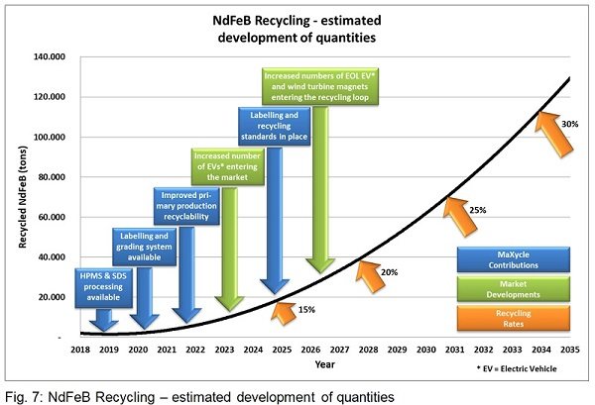
Goals
It is the consortium’s ambition that by 2025, with the new labelling and recycling standards being in place, an effective recycling rate of 15% is achieved.

